Slide 1
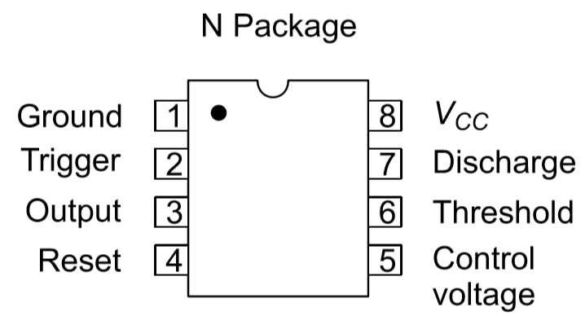
IC 555 Timer
The positive supply connected to pin 8 (VCC) and the negative supply to pin 1 (Ground), while the output at pin 3 can switch between a HIGH level (≈ VCC−0.5 ) and a LOW level (≈ 0.1 V).
The internal operation is based on two comparators monitor input voltages and control the internal flip-flop state.
Internal voltage divider: The voltage divider arrangement with resistors arrange for the threshold voltages for upper and lower comparators with 2/3Vcc and 1/3Vcc.
The control voltage pin is used for external modulation of reference levels and generally bypassed with 0.1uF capacitor to remove noise.
Pins 2 and 6 act as trigger and threshold pins to change the state of output.
Trigger operation sets output to high when the voltage at pin2 reduces below 1/3 Vcc.
When at pin 6 voltage increases by 2/3 Vcc the output state goes high resetting the flipflop forcing Q to zero.
The reset pin (pin 4) can force the output LOW when its voltage drops below 0.4 V. while the internal discharge transistor 𝑄1Q1 ​ connected to pin 7 conducts when the output is LOW to discharge the external capacitor and turns OFF when the output is HIGH.

Slide 2
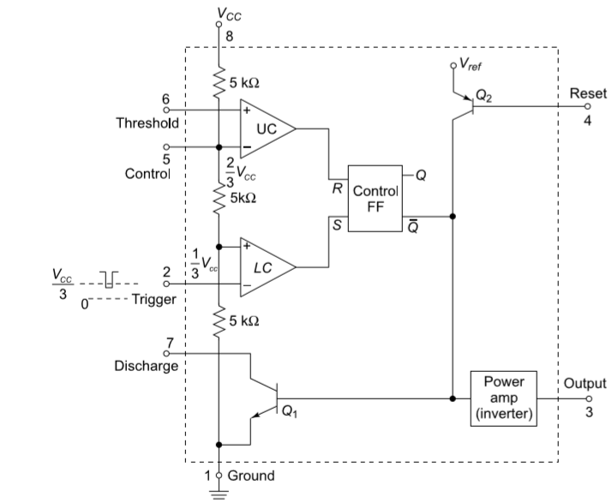

Slide 3
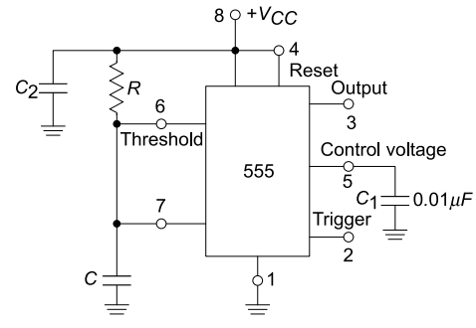
Monostable Multivibrator
Monostable multivibrator has one stable state and one quasi-stable state. It is also known as monoshot or one-shot multivibrator or uni-vibrator.
It remains in its stable state until an input pulse triggers it into its quasi-stable state. It stays in quasi-stable state for a time duration determined by an RC timing circuit.
Post RC time o/p returns to standby or stable state.
The circuit is built by connecting a resistor between pin 8 and pin6.
A capacitor is connected to pin 7 and shorted to pin 6. This RC network decides the pulse width or time constant of the pulse.

Slide 4
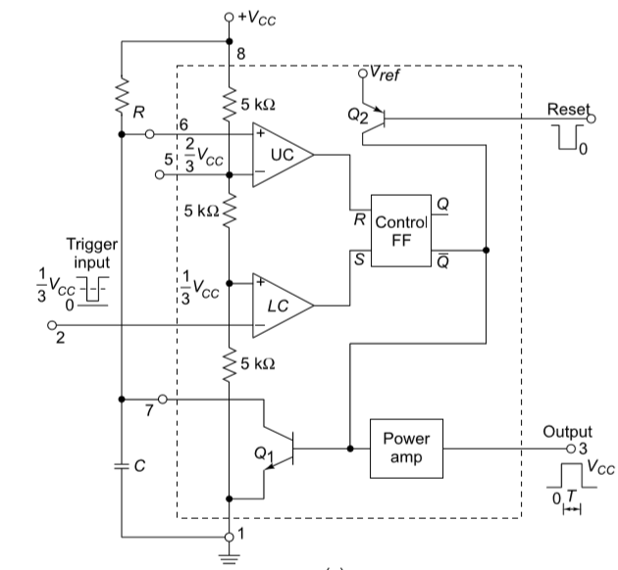
Firstly UC and LC are given with 2/3 voltage for V- and 1/3 voltage for V+ respectively with voltage divider arrangement.
Pin number 2 is held at a voltage higher than 1/3Vcc.
Initially the output of flipfop is 0 making Q_{bar}to 1 and Q1 ON.
The output of 555 timer is logic 0 or zero volts at output.
Now LC provides O/p logic zero since pin2 is more than 1/3Vcc
Since capacitor initial charge is zero, UC also provides output logic zero.
The flipflop retains earlier state as 0

Slide 5
Now a small trigger of potential less than 1/3Vcc is applied at pin2
LC shifts output to +Vsat aka logic 1.
The UC still maintains logic zero at output as charge on capacitor is still zero.
SR flipflop with S=1 and R=0 makes Q=1
This makes Qbar=0 and Q2 OFF
Output of 555 times is logic high or saturated voltage at output.
Since Q1 off the capacitor is unclamped and starts to charge.
The capacitor charges via the resistor R connected to pin8.

Slide 6
When the charge on capacitor exceeds 1/3Vcc the LC shifts o/p to logic 0. This makes S of FF as zero.
When the charge on capacitor exceeds 2/3Vcc, then UC shifts o/p to logic 1.
The FF has S=0 and R=1
This makes output Q=0 and Qbar=1 and Q1 ON
As soon as Q1 is ON, the capacitor clamps to transistor and discharges via the transistor to ground potential.
The output of 555 timer reverts back to zero.
This generates a pulse width of certain time period and then reverts back to its standby mode or stable mode hence monostable multivibrator.
The output remains zero until another trigger pulse is applied at pin 2.
For proper monostable operation with the 555 timer, the negative-going trigger pulse width should be kept shorter compared to the desired output pulse width.

Slide 7
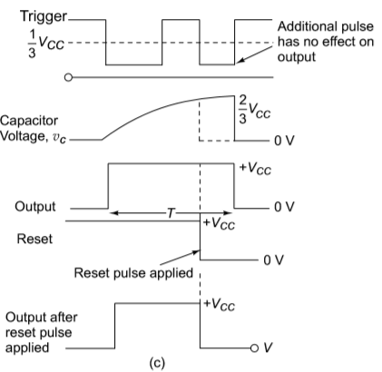
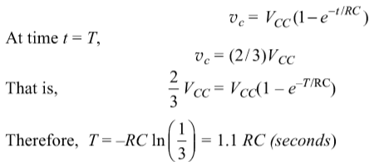

Slide 8
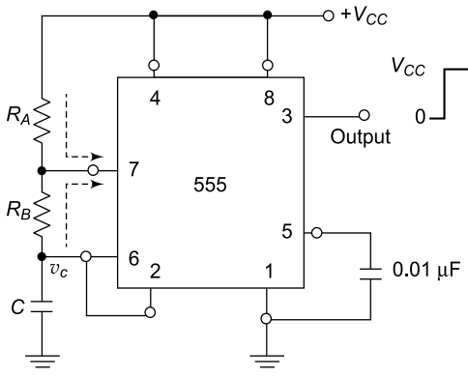
Astable Multivibrator
Astable multivibrator has no stable state and continuously oscillates between HIGH and LOW output levels.
It generates a continuous square wave without any external trigger.
The oscillation frequency and duty cycle are determined by external resistors RA, RB and capacitor C.
Pins 2 and 6 are connected together to monitor the capacitor voltage.
Charging and discharging of capacitor between 1/3 VCC and 2/3 VCC produces oscillations.

Slide 9
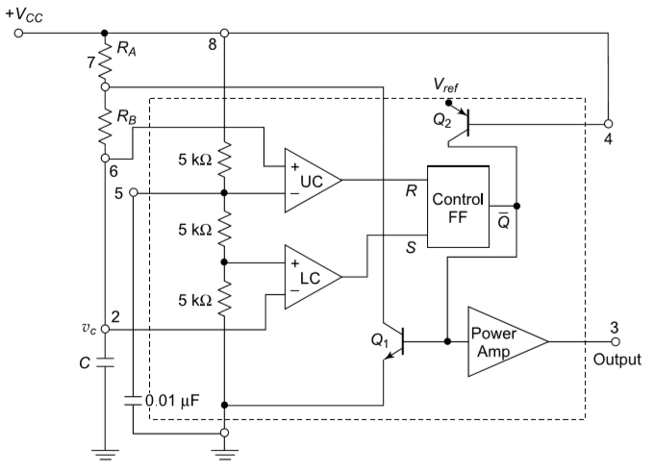
Initially the capacitor voltage VC is approximately 0 V.
Since VC < 1/3 VCC, the trigger comparator sets the flip‑flop.
Output becomes HIGH: Vout ≈ VCC.
Discharge transistor Q1 becomes OFF.
The capacitor begins charging through resistors RA and RB toward VCC.
Capacitor charges through RA and RB with time constant (RA + RB)C.
The capacitor voltage increases exponentially toward VCC.
Charging equation: VC(t) = VCC(1 − e^(−t / ((RA + RB)C))).
When Vc exceeds 1/3Vcc output of LC becomes logic zero.
When VC reaches the threshold level 2/3 VCC the upper comparator activates.
This causes the flip‑flop to reset.

Slide 10
When VC = 2/3 VCC the upper comparator output becomes HIGH.
The flip‑flop resets making output LOW.
Output voltage becomes approximately 0 V. Qbar becomes high or logic 1.
The discharge transistor Q1 turns ON.
The capacitor gets a path from Rb to ground via transistor Q1.
The capacitor now begins discharging through RB only.
During discharge the capacitor voltage decreases exponentially toward 0.
Discharging equation: VC(t) = (2/3)VCC e^(−t / (RB C)).
When VC falls to 1/3 VCC the lower comparator triggers.
The flip‑flop sets again making output HIGH.
The discharge transistor turns OFF and charging starts again.
.

Slide 11
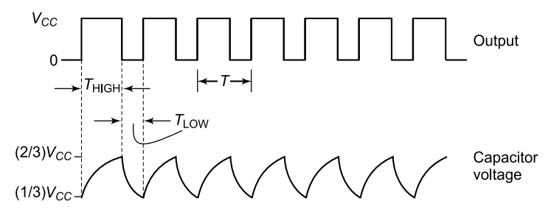

Slide 12
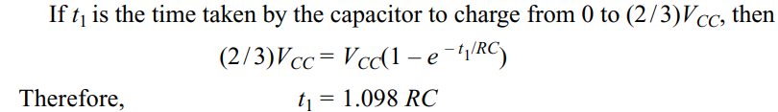
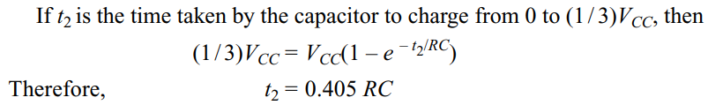
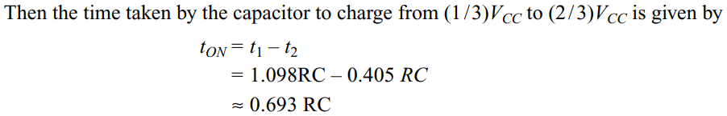

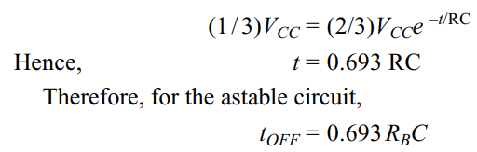


Slide 13
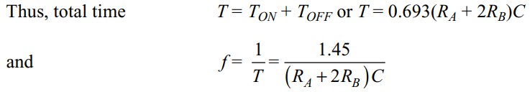
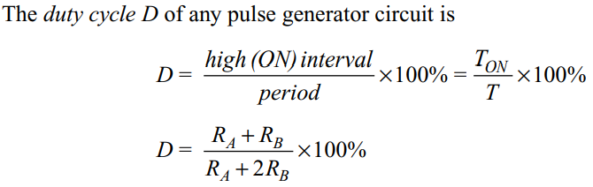

Slide 15
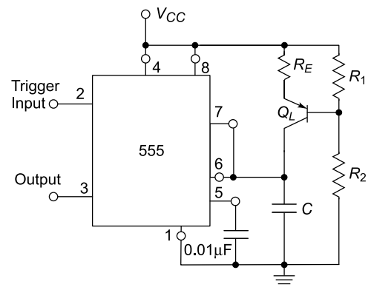

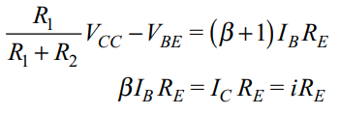
Applications of Monostable Multivibrator Ramp Generator
A linear ramp (sawtooth) signal is generated by charging a capacitor with a constant current source instead of a resistor.
If the capacitor C is charged by a constant current i, the capacitor voltage is obtained by integrating the current over time
The transistor 𝑄𝐿 acts as a constant current source, supplying a nearly fixed current to the capacitor regardless of the capacitor voltage.
KVL form base to emitter gives

Slide 16

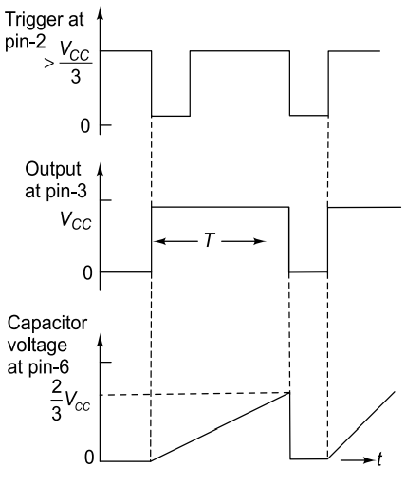
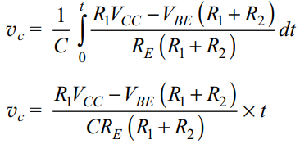


Applications of Monostable Multivibrator

Slide 17
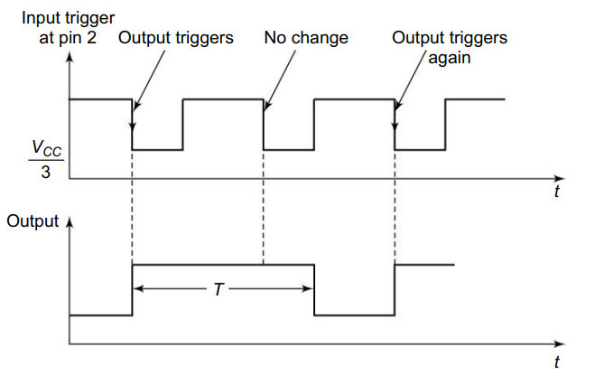
Frequency divider
A monostable multivibrator can function as a frequency divider when it is continuously triggered by a square-wave signal.
The timing interval 𝑇 of the monostable must be greater than the period of the input square wave so that the circuit does not respond to every trigger.
The monostable is triggered by the first negative edge of the input square wave, causing the output to switch HIGH
When the second negative edge arrives, the monostable is still in its active state because 𝑇
By the time the third negative edge occurs, the timing interval has completed and the monostable has returned to its stable state, allowing it to trigger again.
Since the monostable responds only to alternate input edges, the output frequency becomes a fraction of the input frequency.

Slide 18
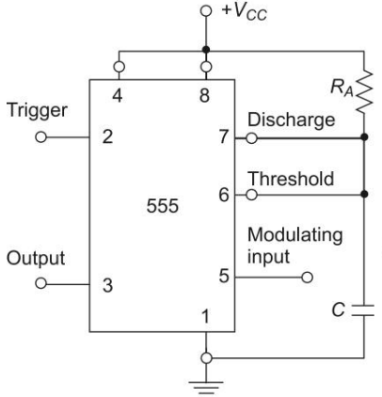
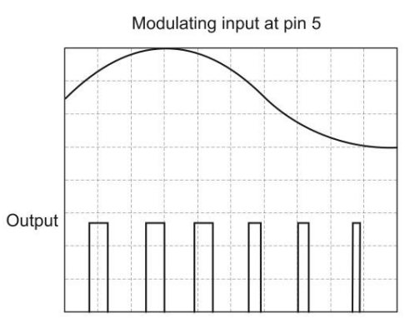
Pulse Width Modulator
By giving modulating control signal at pin5 555 timer can act as a pulse width modulator.
A sequence of trigger pulses applied to pin 2 produces a corresponding sequence of output pulses at the output terminal.
The width of each output pulse depends on when the upper comparator resets the flip-flop, which occurs when the capacitor voltage reaches the comparator threshold.
The modulating signal applied at pin 5 alters the threshold voltage of the upper comparator. Normally this threshold is 2/3𝑉_{𝐶𝐶} ​.
The modulating signal is superimposed on the internal voltage divider voltage, causing the threshold level to increase or decrease.
Because the capacitor must charge to this varying threshold, the time taken to reach the threshold changes, which changes the pulse width of the output.
The trigger pulses determine the output frequency, so the frequency remains constant (trigger pulse frequency), while the duty cycle varies according to the modulating signal.

Slide 19
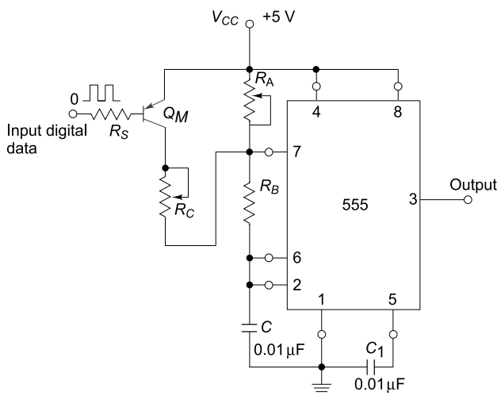


Applications of Astable Multivibrator FSK Generator
FSK mechanism transmits data with different frequencies for logic 0 and logic 1.
In this circuit, a 555 timer is configured in astable mode so that it continuously generates square-wave oscillations.
Initially the astable multivibrator operator works with a fixed frequency of
The digital input applied to the circuit typically has a low frequency such as 150 Hz and represents the binary data to be transmitted.
When the input signal is HIGH, transistor 𝑄𝑀​ remains OFF. In this condition, the 555 timer operates like a normal astable multivibrator.
When the input signal becomes LOW, transistor 𝑄𝑀 ​ turns ON. This connects an additional resistor 𝑅𝐶 in parallel with 𝑅𝐴 ​.
Because 𝑅𝐶 is connected across 𝑅𝐴 the effective resistance becomes 𝑅𝐴∥𝑅𝐶​. This reduced resistance alters the charging path of the capacitor.
The new oscillation frequency produced when QMQ_MQM​ is ON is given by
As the digital input switches between HIGH and LOW, the output alternates between two different frequencies, thereby encoding binary data using the FSK modulation technique.

Slide 20
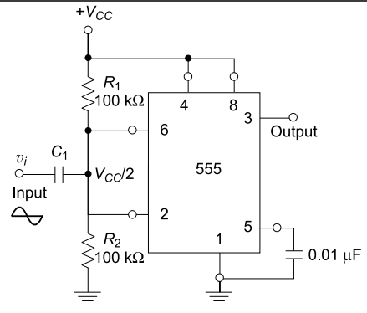
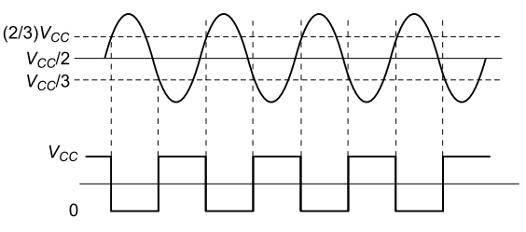
Schmitt Trigger using 555 timer
The timer IC 555 can be used to function as a Schmitt trigger with variable threshold voltage levels.
The two internal comparator inputs (pins 2 and 6) are connected together and externally biased with a voltage VCC /2 through R1 and R2 potential divider network.
Since the voltage at pins 6 and 2 will trigger the upper comparator (UC) at (2/3)VCC and the lower comparator (LC) at (1/3)VCC , the bias provided by R1 and R2 is centered within these two threshold levels.
When a sine wave input of sufficient amplitude (vi ), where vi is greater than [(2/3)VCC – (1/3)VCC] is applied to the circuit, it causes the internal flip-flop to alternatively Set and Reset generating a square wave output.

Slide 21
Phase Locked Loop (PLL)
With the advancement of integrated-circuit technology PLL circuits became fundamental building blocks in modern electronics
PLLs are widely used in systems such as FM stereo decoders, motor speed control systems, tracking filters, frequency synthesizers in transmitters and receivers, FM demodulators, FSK decoders, and local oscillator generation in TV and FM tuners.
A phase-locked loop consists of three main components:(1) Phase detector,(2) Low-pass filter, and(3) Voltage-controlled oscillator (VCO).
The phase detector compares the input frequency 𝑓𝑖​ with the feedback frequency from the VCO and produces an output proportional to their phase difference.
The output of the phase detector is a dc voltage proportional to the phase error, commonly called the error voltage.
The low-pass filter removes high-frequency noise and ripple from the detector output and produces a smoother dc control voltage.
In addition to filtering noise, the low-pass filter also determines the dynamic response and stability of the PLL.

Slide 22
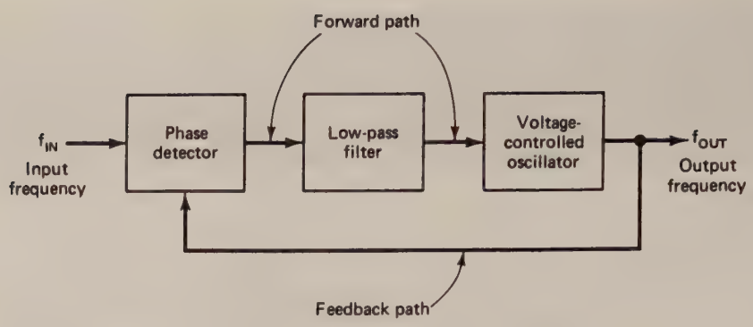
Phase Locked Loop (PLL)
The filtered dc voltage is applied to the voltage-controlled oscillator, whose output frequency is directly proportional to the input control voltage.
The VCO output is continuously compared with the input signal, and its frequency is automatically adjusted until both signals match.
Before the input signal is applied, the VCO oscillates at its natural free-running frequency called free running state.
When the input signal is applied, the VCO frequency begins to change under the influence of the control voltage, and the PLL enters the capture mode.
When the VCO frequency becomes equal to the input frequency, the loop reaches the phase-locked condition.
Once locked, the PLL can track small changes in the input frequency by continuously adjusting the VCO frequency.

